Slide 1
Laser Light Show
ELEC 391 – Group B1

Slide 2
Simulink Model

Slide 3
RCGs
Requirements
Usable PID Values Obtained
Encoder Detects All Pulses
Constraints
Control Frequency of 1000 Hz
Max Motor Current ( < 2A )
Goals
Rise Time ( < 0.017 s )
Overshoot ( < 10 % )
No Breadboards
Max Encoder Resolution ( 400 pulses )
Simulink Model of Motor Within 5 % Error
Support shapes with >5 vertices

Slide 4
The Process
Building Motors
System Integration
Control

Slide 5
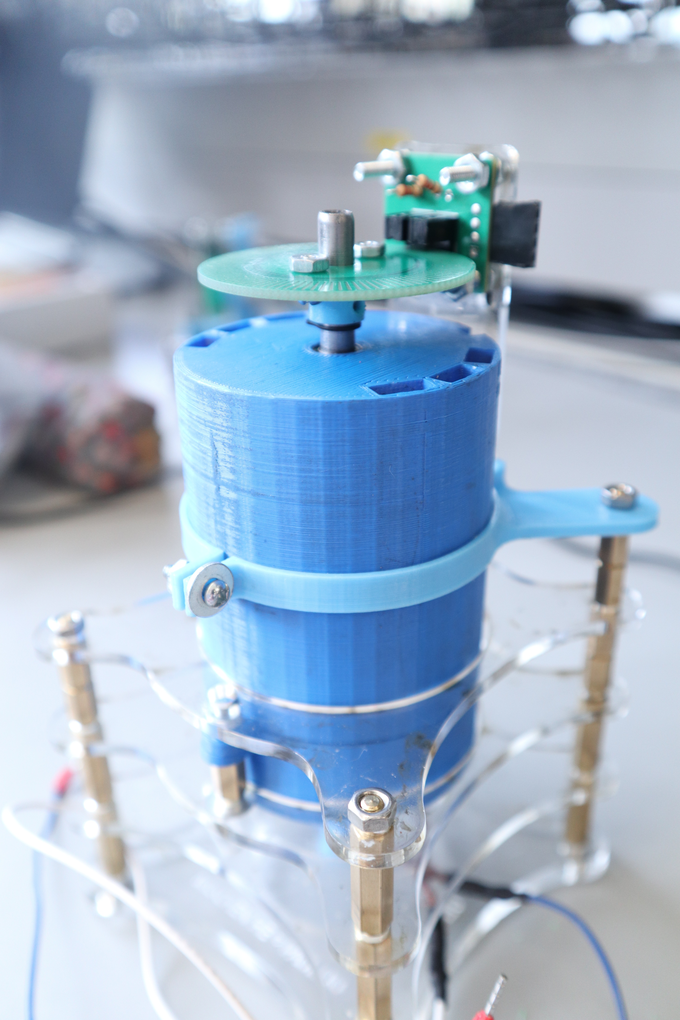
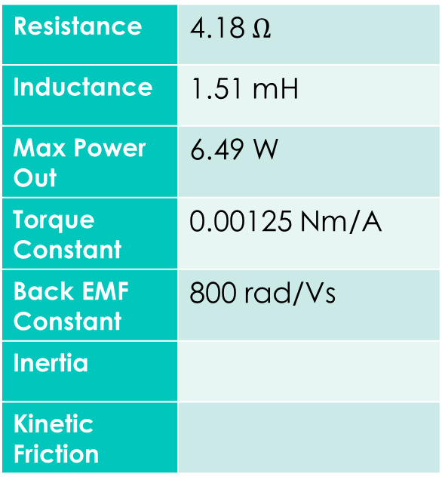
YAW
Resistance | 4.18 $Ω$
Inductance | 1.51 mH
Max Power Out | 6.49 W
Torque Constant | 0.00125 Nm/A
Back EMF Constant | 800 rad/Vs
Inertia
Kinetic Friction

Slide 6
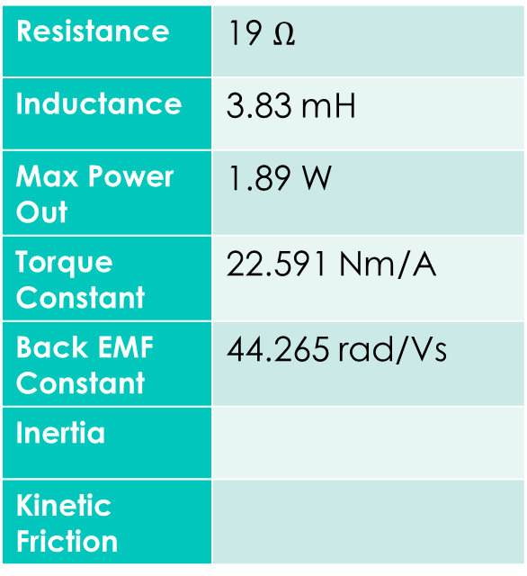
PITCH
Resistance | 19 $Ω$
Inductance | 3.83 mH
Max Power Out | 1.89 W
Torque Constant | 22.591 Nm/A
Back EMF Constant | 44.265 rad/Vs
Inertia
Kinetic Friction

Slide 7

Checking Motor Parameters

Slide 8
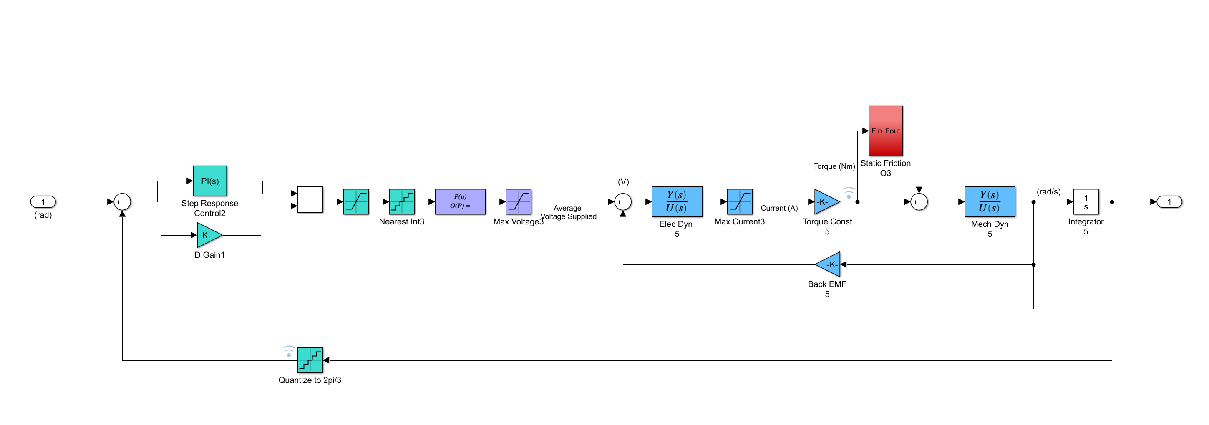
Simulink Model with PID Control
Static Friction and Cogging
PWM Value between
0 - 255
Maps PWM to Average Voltage
Output Position
Input Step
Derivative Gain on Velocity
Quantizes Angle to Encoder Resolution
Motor Transfer Function

Slide 9
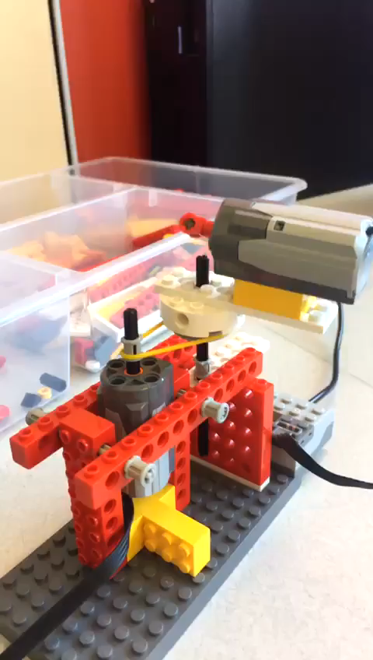
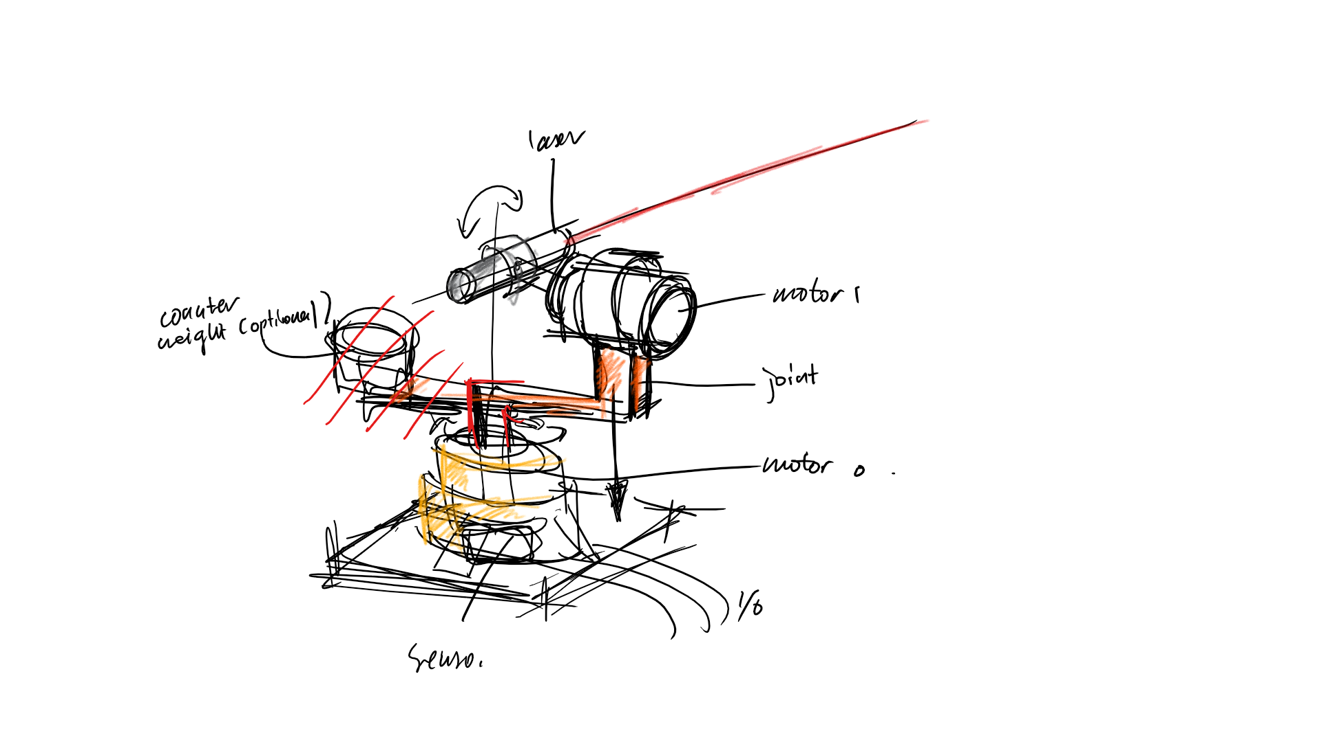
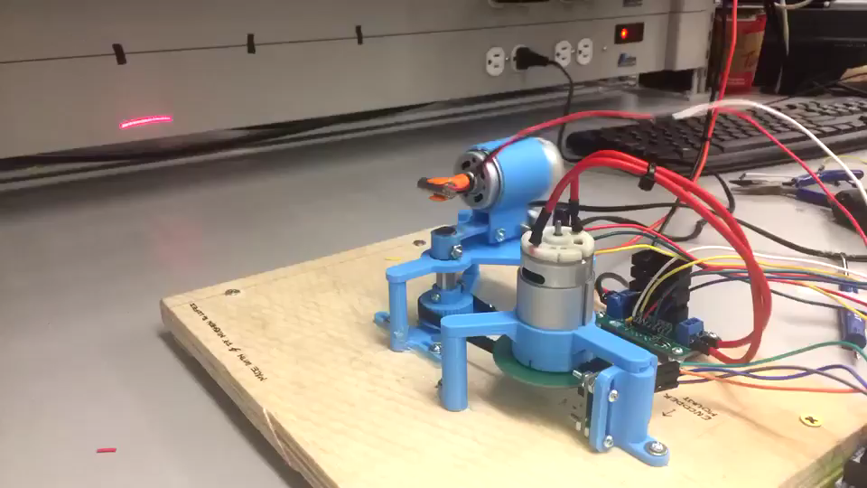
1…
2…
3…
SYSTEM

Slide 10
Controller Logic
State 1
Homing Yaw Motor
State 2
Homing Pitch Motor
State 3
Listen
State 4
Draw
wait for motor to push limiter switch
wait for laser to hit photoresistor
input desired positions through web app
send to microcontroller
execute control for desired positions

Slide 11
Controller Logic
State 01
State 11
Increment
State
<A> <B>
Decrement
State 00
State 10

Slide 12
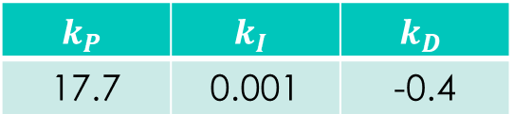
Initial Control
Aim for fastest rise time and small overshoot
Ensure system is stable
Overshoot | 14.28 %
Rise Time | 0.1 s
Settle Time | 2 s
$$k_{P}$$ | $$k_{I}$$ | $$k_{D}$$
17.7 | 0.001 | -0.4

Slide 13
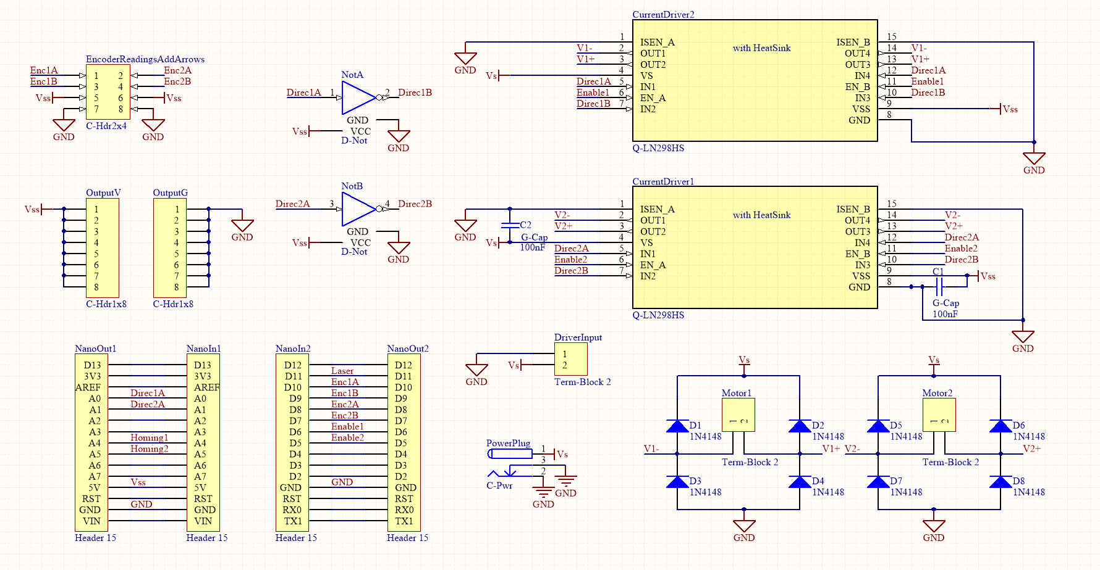
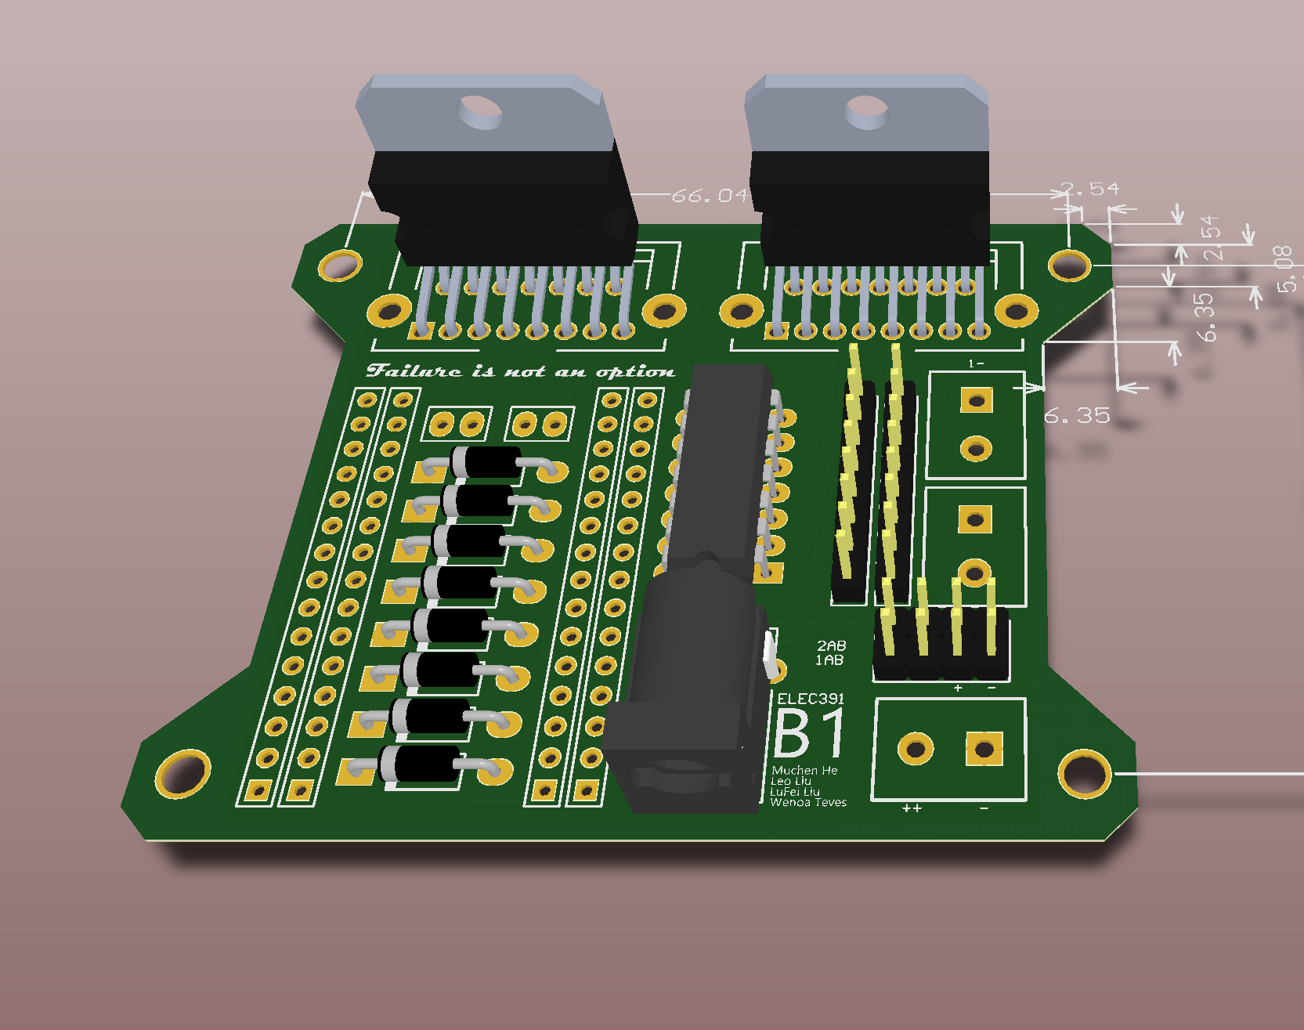
System PCB
Current Drivers
Pins from Encoder
Not Gates (for motor direction)
Extra 5V Pins
12V Input Pins
12V Input Plug
Arduino Base
Diode Bridge

Slide 14




Coordinate Mapping Application
1
2
-0.7, 0.6
0.8, -0.2
3
4
-0.7, 0.6
$$θ1$$
$$θ2$$
0.8, -0.2
$$θ1$$
$θ1$ = 7 pulses

Slide 15
Mapping
1
2
-0.7, 0.6
0.8, -0.2
To Controller
Map desired laser path to list of coordinates
Inverse kinematics are applied to obtain angles
Angles are converted to encoder positions
Time vector is generated based on length of each line segment
3
4
Points:
< n pulses >
Time:
< relative length>
-0.7, 0.6
$$θ1$$
$$θ2$$
0.8, -0.2
$$θ1$$
$θ1$ = 7 pulses

